Slide 1
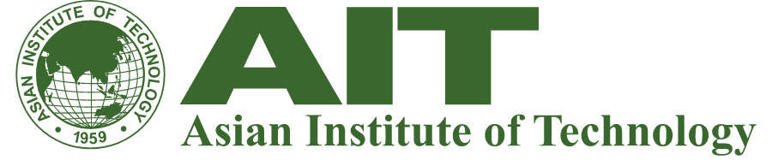



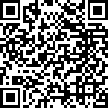
Multi-Hazard Impacted-Based Forecast and Warning Systems
8-19 September 2025
Forecasting hazards is not enough; we must anticipate their impacts to truly save lives and livelihoods.
Shape the Future of Safety: Join Our MHEWS Training!
The world needs a new approach to disaster preparedness. Multi-Hazard Impact-Based Forecast and Warning Systems (MHEWS) are the answer, shifting us from what might happen to what the impact will be – saving lives and livelihoods. Ready to lead this critical change?
Join our intensive training course and gain the expertise to build and implement these vital systems. Learn to integrate data, predict impacts, and empower communities.
In this course, Participants will:
Design & Manage EWS: Develop, oversee, and enhance complex early warning systems for various hazards and climate impacts.
People-Centered Warning: Learn to create effective warning systems that truly serve and empower communities.
Expert Insights: Benefit from ADPC and AIT’s decades of leading regional disaster management.
System Evaluation & Improvement: Gain skills to assess current systems, identify weakness, and implement crucial enhancements.
This training course is a hybrid modality:
Scan for further course details
Online Phase: 8-14 September 2025
Face to Face Phase: 15-19 September 2025
For further course details and registration, please visit www.adpc.net/apply or contact academy@adpc.net.

